Slide 1
Big Mountain Resort

Slide 2
Problem Identification
Big Mountain Resort is expecting about 350,000 visitors this season. Due to their large anticipated crowds and expanded traffic throughout the resort, it has installed an additional chair lift. This additional lift has increased the operation cost of this season by $1.54 million.
In order to combat this increased cost of operations, Big Mountain has decided to increase its ticket prices. Currently, Big Mountain Adult Weekend ticket price is $81.
The problem at hand now is by how much should the resort increases its prices, and are further changes needed to combat this new cost of operations and secure revenue. Making sure not to alter any amenities/features that is in favor for the resort.

Slide 3
Recommendation & Key Findings
The model found a few potential scenarios to combat the pressing issue:
Closing a few runs (up to 10 least -used runs)
Add a run, increasing the vertical drop, and installing an additional chair lift
Supports an $1.99 ticket price increase, project to $3.4 million in revenue
Similar to second option
Supports an $1.99 ticket price increase, project to $3.4 million in revenue
Increase the longest run by 0.2 miles, requires an additional 4 acres of snow coverage
Less profitable potion

Slide 4
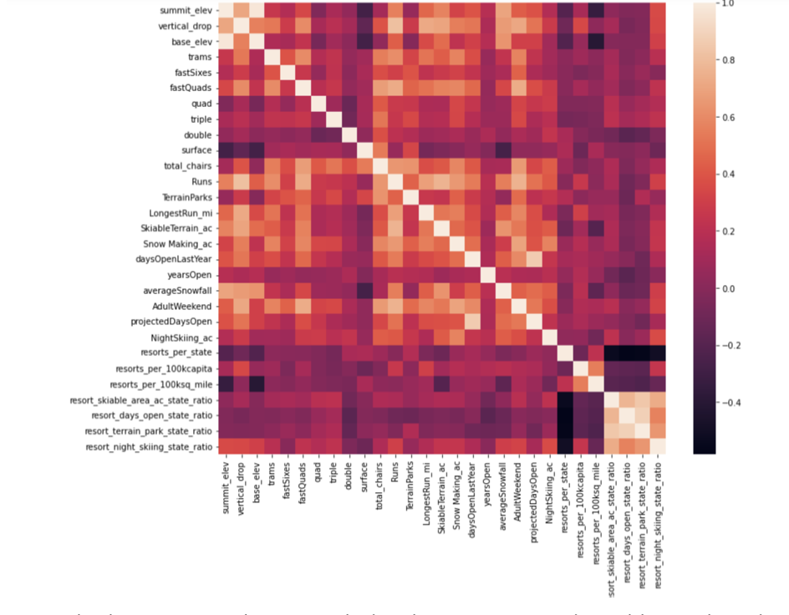
Modeling Results & Analysis
From the heat map, you can see:
A strong correlation between summit and base elevation
Resort_night_skiing_state_ratio shows the most correlation to ticket prices
A possible positive price change for the resort
The relationship Runs and total_chairs show is correlated to ticket prices
More runs = More people
But also more lifts and higher operation cost

Slide 5
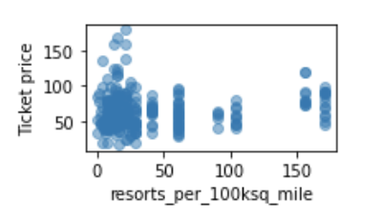
Modeling Results & Analysis
The above figure shows a possible ticket price rise as the area is heavily populated indicating popularity and ultimately high demand.
As well as high prices when the resort is located in a rare area.

Slide 6
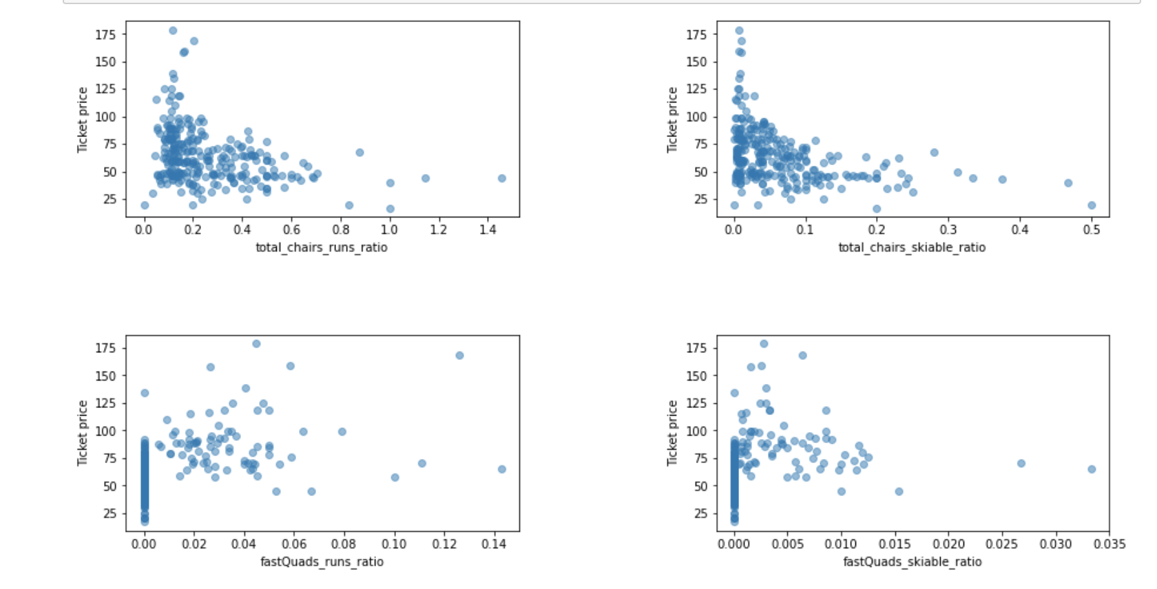
Modeling Results & Analysis con.
The more chairs a resort has relative to the runs, ticket prices fall and stay consistently low. With less chair you could charge higher prices but it will be limited the amount of visitors in a day.
It also shows that have no fast quads can limit the prices. Keep in mind, this is not the case for smaller resorts in which getting a couple of fast quads may be beneficial.

Slide 7
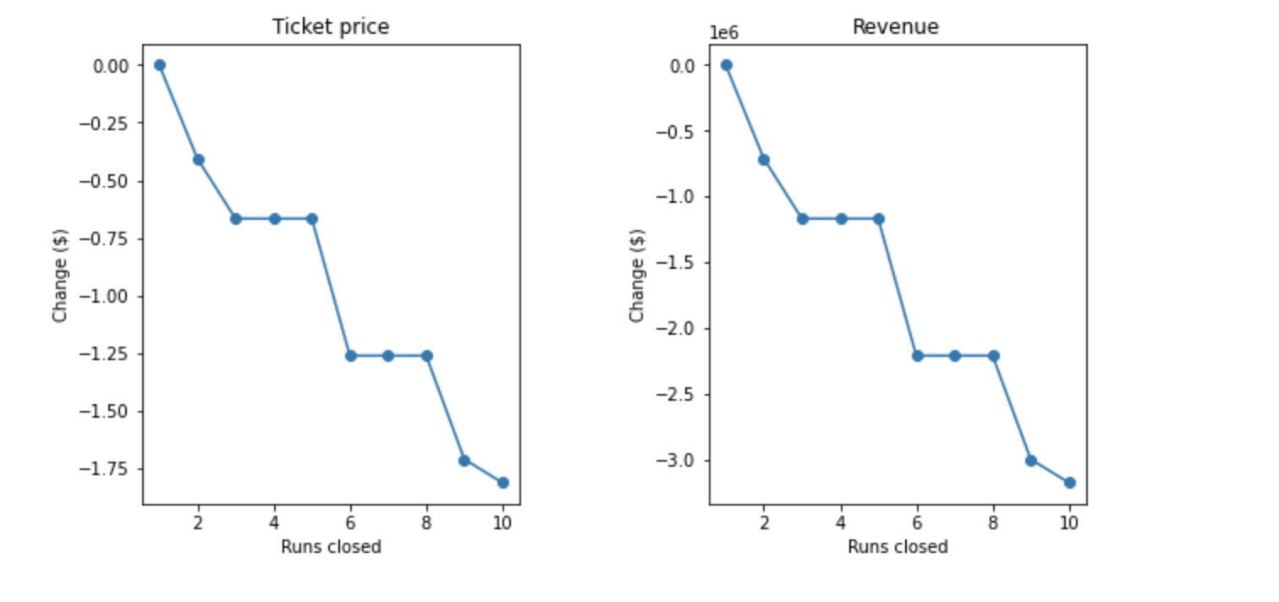
Modeling Results & Analysis
The above graphs shows closing one run has no difference on ticket price and revenue.
But did show support for ticket prices if 2 or 3 runs were reduced.
This trend comes as more runs are removed.

Slide 8
Conclusion
The most profitable options to combat the increased cost of operations are:
Additional run or Increase length of the longest run
Factors/Features to keep in mind are:
night skiing, snowmaking, vertical drop , and population size
Additionally may want to be get visitors feedback

